Slide 1

Welcome
Data Skills 1
Week 3: Decimals

Slide 2
Today’s lesson
Homework review
Week 2 recap
Understanding decimal numbers
Reading and writing decimals numbers
Rounding decimal numbers
Adding and subtracting decimal numbers
Critical thinking: understanding Covid data

Slide 3

Homework review & week 2 recap

Slide 4
Week 2 quiz
Any questions or problems?
Notes:
Please go over any problems areas with students.
If you have time before class, please check completion rates by searching for your students. As I mentioned, I’m trying to work on a quicker way of accessing your class results, but for now, please search manually.

Slide 5
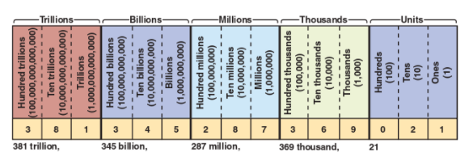
Week 2 Recap
How would you read/write the following (use the chart to help you):
3,487 72,896 111,984
10,456,733 89,090 124,569,876

Slide 6
Understanding decimal numbers

Slide 7
What are decimal numbers?
A decimal is a number that is not whole.
Decimal numbers are 'in between' numbers. For example, 10.4 is in between the numbers 10 and 11. It is more than 10, but less than 11.
Why do we need decimal numbers? Think of examples of where decimal numbers are commonplace.
https://www.bbc.co.uk/bitesize/topics/zsjqtfr/articles/zsbd7p3
Notes:
Ask students to name instances of when it is important to calculate numbers less than one, e.g. time, money, scientific experiments, etc.

Slide 8


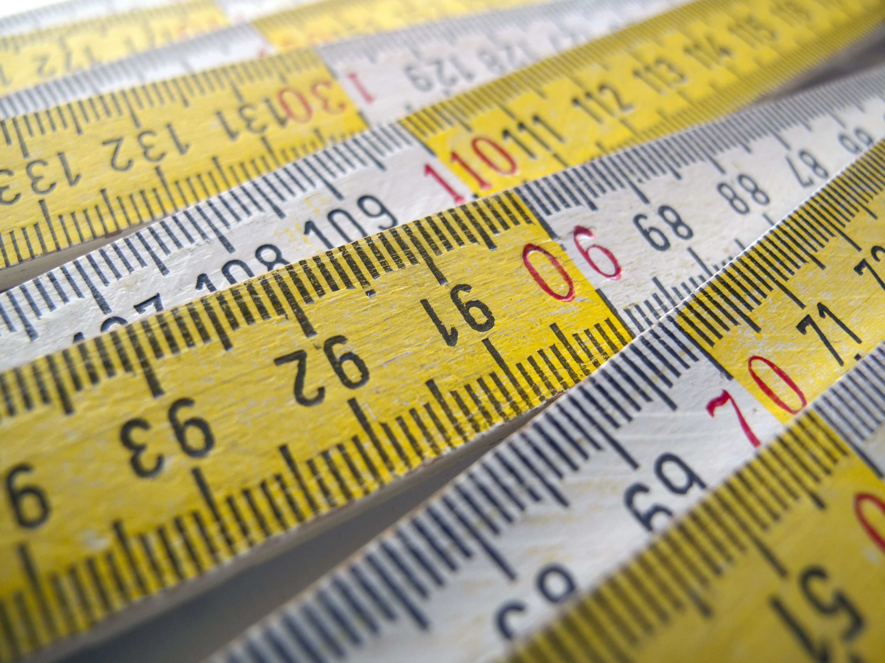
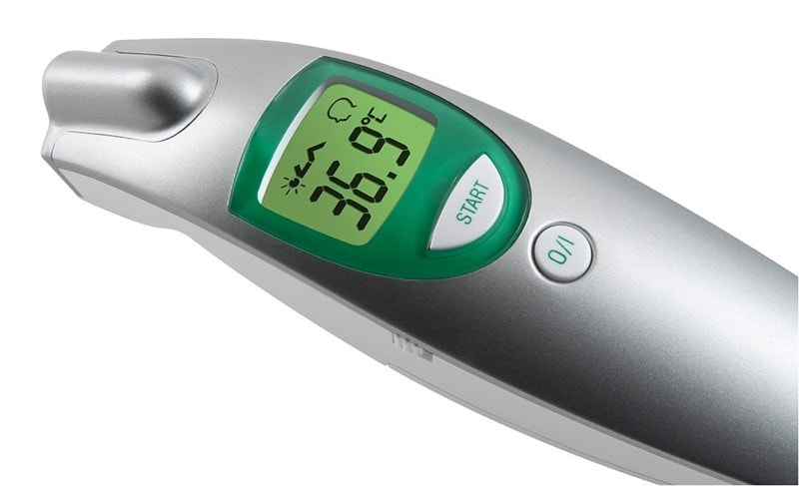
Examples of decimals
Jack’s slice of pizza cost £1.35
In the 2020 Japanese Olympics, Lamont Marcel Jacobs won the 100m sprint in a time of 9.80 seconds
An inch is equal to 2.54cm
The average body temperature is 98.6Fahrenheit
https://www.teachervision.com/decimals/understanding-decimal-place-value

Slide 9
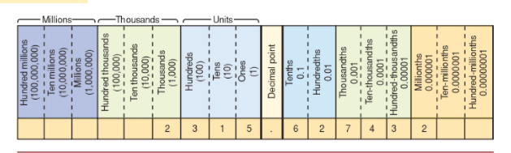
Naming decimal values
Remember the names for whole numbers?
The names are similar for decimals, but we add certain letters, as you can see from the chart.
We read the digits to the right of the decimal point, which always end in the letters th or ths, e.g. tenths, hundredths, thousandths etc.
In terms of size, which do you think is bigger, a ‘tenth’ or a ‘thousandth’?
Notes:
You could do a quick recap on the value names for whole numbers.

Slide 10
Reading and writing decimal numbers

Slide 11
Reading and/or writing decimal numbers
METHOD 1
Read or write the whole number part as you would read or write a whole number.
Use the word ‘and’ for the decimal point.
Read or write the decimal part as you would read or write a whole number.
Read or write the decimal value.
So,‘3.12’ would be read or written as three and twelve hundredths.
METHOD 2
Read the whole number part as you would read a whole number.
Use the word ‘point’ for the decimal point.
Read each individual number to the right of the decimal.
So,‘3.12’ would be read as three point one two, although we wouldn’t write this.
Notes:
The two methods are not entirely comparable as you would never write ‘three point one two’, so explain Method 2 is purely oral.
In addition, ‘Business Math Brief’ says the second method is ‘informal’, however, I think this is much more common in British English, but it doesn’t so easily give the sense of the size of the decimal number.

Slide 12
Examples
a) 9.7
b) 11.59
nine and seven tenths
eleven and fifty-nine hundredths
c) 1045.658
one thousand, forty-five and six hundred fifty-eight thousandths
d) 5,600,000.0072
five million, six hundred thousand and seventy-two ten thousandths
Notes:
Point out that when whole numbers combine with decimals, it’s easier to adopt the American pronunciation and omit the ‘and’ when saying whole numbers that are above one hundred, as in examples c) and d). Otherwise ‘and’ is used too often and may cause confusion.

Slide 13
Practice
Write the following in words using Method 1. The first one has been done for you as an example.
5.8
0.721
789.48
1,341.466
5,656.65
0.09
1.8
45,978.8775
Five and eight tenths

Slide 14
Answers
2) Seven hundred and twenty-one thousandths.
3) Seven hundred eighty-nine and forty-eight hundredths.
4) One thousand, three hundred forty-one and four hundred sixty-six thousandths.
5) Five thousand, six hundred fifty-six and sixty-five hundredths.
6) Nine hundredths.
7) One and eight tenths.
8) Forty five thousand, nine hundred seventy-eight and eight thousand seven hundred seventy-five ten thousandths.

Slide 15
Further practice
To qualify for NASCAR’s Daytona 500, car racers must achieve an average speed of 171.6 mph. Below are the results of a qualifying race.
1. Which racers did not qualify?
Racer | Average Speed (mph) | Racer | Average Speed (mph)
Bobby Labonte | 180.342 | Tony Stewart | 176.901
Ward Burton | 173.712 | Ricky Rudd | 172.124
Dale Jarrett | 172.224 | Mark Martin | 180.348
Dale Earndhardt | 181.159 | Rusty Wallace | 171.599
Sterling Martin | 171.066 | Jeff Gordon | 173.756
2. Who was faster, Dale Jarrett or Ricky Rudd?
3. Assuming the racers maintained these average speeds in the actual race, who would come in 1st, 2nd and 3rd?
4. How many thousandths of a mile per hour faster did Rusty Wallace need to drive in order to qualify?
5. Of the qualifiers, who should come in last place?
Notes:
Source: teachervision.com/decimals/winning-decimals

Slide 16
Answers
Sterling Martin and Rusty Wallace
Dale Jarrett
1st: Dale Earnhardt; 2nd: Mark Martin; 3rd Bobby Labonte
One thousandth of a mile per hour
Ricky Rudd

Slide 17
Rounding decimal numbers

Slide 18
Rounding decimal numbers
As we saw in the previous lesson, ‘rounding’ involves determining whether a particular number should either be increased or remain the same. The decision is based on the value to right of the number to be rounded. We can follow a similar procedure for rounding decimals as we did for rounding whole numbers.
Find the place where the number is to be rounded. Draw a vertical line after that place to show that you are cutting off the rest of the digits.
Step 1
Step 2
Drop (delete) all digits to the right of the place to which you have rounded.
Look at only the first digit to the right of your cut-off line. If the first digit is 5 or more, increase the digit in the place to which you are rounding by 1. Otherwise, do not change the digit in the place to which you are rounding.
Step 3

Slide 19
Examples
Round 87.562 to the nearest tenth
87.5|62 (the 5 is in the tenths place and a vertical line is placed after this)
The number to the right is 6, which is more than 5, so increase 5 by 1, therefore 87.562 rounds to 87.6
Round 3678.5928 to the nearest hundredth
3678.59|28 (the 9 is in the hundredths place and a vertical line is placed after this)
The number to the right is 2, which is less than 4, so do not change, therefore 3678.5929 rounds to 3678.59

Slide 20
Practice
Round 24.918 to the nearest:
tenth
hundredth
whole number

Slide 21
Answers
Round 24.918 to the nearest:
(a) hundredth
24.918 rounded to the nearest hundredth is 24.92
(b) tenth
24.918 rounded to the nearest tenth is 24.9
(c) whole number
24.918 rounded to the nearest whole number is 25

Slide 22

Further practice
Go to page 96 in your Kortext book and complete ‘Stop and Check’ (questions 1-4).
Check your answers on page. 120

Slide 23
Front-end rounding
As we saw in the previous lesson, sometimes it may be useful to give an estimation rather than an exact figure. This allows you to quickly work out the calculation.
In order to do this, we use ‘front-end rounding’, meaning taking the number furthest to the left and rounding either up or down depending on the number immediately to the right of it.
Exact figure | Approximation
$1783.38 | $2000
$4341.15 | ?
$2175.94 | ?
$896.23 | ?
$2562.53 | ?
Total = $11,759.23 | Total =?

Slide 24
Answers
$1783.38
?
$4341.15
?
$2175.94
?
$896.23
?
Total = $11,759.23
Total =?
Exact figure | Approximation
$1783.38 | $2000
$4341.15 | £4000
$2175.94 | $2000
$896.23 | $900
$2562.53 | $3000
Total = $11,759.23 | Total =11,900

Slide 25

Take a Break

Slide 26
Adding and subtracting decimal numbers

Slide 27
Adding and subtracting decimals
You will not be required to add or subtract decimal numbers, manually.
Let’s look at how to do this on a calculator.
We’ll look at another section of the same video we saw in Week 2.
https://youtu.be/x-2HjO4iGXI
Watch from: 1 minute 18 seconds – 1 minute 48 secs

Slide 28
Practice
Calculate the following (using a calculator):
45.93 + 14.017 + 96.5432
17.53 – 12.17
542.83-219.593
Garza Humada bought a shirt for £18.97 and paid with a £20 note. What was the change?
The stock of FedEx Corporation had a high for the day of £120.01 and a low of £95.79, closing at £117.58. By how much did the stock price change during the day?

Slide 29
Answers
156.4902
5.36
323.237
1.03
24.22
Now….round the answer for numbers 1 and 3 to the nearest hundredth.

Slide 30
Critical thinking: covid data

Slide 31
Working with real world data
Each week we’re going to work with ‘real world’ data. This will help with practicing the maths as well as provide an opportunity to develop critical thinking skills.
Notes:
A definition of ‘critical thinking’ was given in Week 1.

Slide 32
Covid vaccination rates
The table on the right shows the top 10 European countries in terms of total vaccine doses administered per 100 of the population.
Round each number to the nearest whole number.
Country | Total vaccine doses administered per 100 of the population
Portugal | 268
Denmark | 259.7
Belgium | 252.5
Italy | 251.3
Malta | 248.6
Ireland | 245
Finland | 239
Iceland | 237.3
Spain | 235.3
France | 233.5
Notes:
The figures come from the WHO: https://covid19.who.int/table
Table updated in January 2023.

Slide 33
Answers
Country | Total vaccine doses administered per 100 of the population
Portugal | 268
Denmark | 259.7
Belgium | 252.5
Italy | 251.3
Malta | 248.6
Ireland | 245
Finland | 239
Iceland | 237.3
Spain | 235.3
France | 233.5
Country | Total vaccine doses administered per 100 of the population
Portugal | 268
Denmark | 260
Belgium | 253
Italy | 251
Malta | 249
Ireland | 245
Finland | 239
Iceland | 237
Spain | 235
France | 234

Slide 34
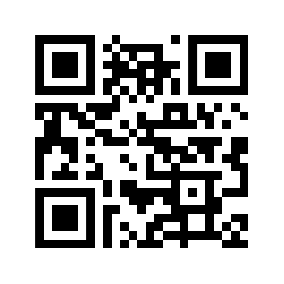
Further practice
Find your own country on the table.
What is the figure for ‘persons boosted per 100 of the population’?
Round to the nearest tenth.
Notes:
Ask students to scan the QR code which will take them to the website.

Slide 35
Covid death rates
Here are two lists of the top 5 countries by covid deaths. Why do you think they are different?
List 1 | List 2
1. USA | 1. Peru
2. Brazil | 2. Bulgaria
3. India | 3. Hungary
4. Russia | 4. Bosnia and Herzegovina
5. Mexico | 5. North Macedonia

Slide 36
Absolute v. proportional numbers
LIST 1 | Total deaths | LIST 2 | Deaths per 1million
1. USA | 1,132,132 | 1. Peru | 6,493
2. Brazil | 696,731 | 2. Bulgaria | 5,577
3. India | 530,739 | 3. Hungary | 5,065
4. Russia | 394,902 | 4. Bosnia and Herzegovina | 5,001
5. Mexico | 332,026 | 5. North Macedonia | 4,631
Notes:
Source: https://www.worldometers.info/coronavirus/#countries

Slide 37
Differences in presenting data
The first list presents an absolute total of covid deaths whereas the second list provides the total number of deaths as a proportion of the population.
What reasons can you think of for presenting data in different ways?
How are ‘deaths per million’ calculated?
Notes:
We will look at similar, ‘proportional’ calculations later in the course when we discuss percentages.
The absolute number of confirmed deaths is divided by the total population and multiplied by 1,000,000.

Slide 38
Why are international comparisons difficult?
Go to the Week 3 tile and open the word document called ‘Comparing Covid Data_Student Version’.
Read the article and highlight any reasons why international comparisons of covid death rates are so difficult.
Discuss your answers in groups.

Slide 39
Extra practice
Kortext page 113 questions 1-20
Notes:
These questions provide further practice on decimal numbers and can be done if you finish all of the other material early and/or feel additional practice is needed in certain areas.

Slide 40
Homework

Slide 41
Homework
Week 3 quiz
Kortext page.115 questions 1-10.
Notes:
Page 115 also includes multiplication and division of decimals which we didn’t cover in today’s lesson but shouldn’t pose any problems when using a calculator. Check with students at the start of the next lesson. The answers for the questions on page 115 are on page 122.

Slide 42
End of Week 3

